Slide 1
Ajax
AJAX stands for Asynchronous JavaScript and XML. AJAX is a new technique for creating better, faster, and more interactive web applications with the help of XML, HTML, CSS and Java Script
Ajax uses XHTML for content and CSS for presentation, as well as the Document Object Model and JavaScript for dynamic content display.
AJAX is a web browser technology independent of web server software.
With AJAX when submit is pressed, JavaScript will make a request to the server, interpret the results and update the current screen. In the purest sense, the user would never know that anything was even transmitted to the server.

Slide 2
Steps of AJAX Operation
A client event occurs
An XMLHttpRequest object is created
The XMLHttpRequest object is configured
The XMLHttpRequest object makes an asynchronous request to the Webserver.
Webserver returns the result containing XML document.
The XMLHttpRequest object calls the callback() function and processes the result.
The HTML DOM is updated

Slide 3
1. A client event occurs
A JavaScript function is called as the result of an event
Example: validateUserId() JavaScript function is mapped as a event handler to a onkeyup event on input form field whose id is set to "userid"
<input type="text" size="20" id="userid" name="id" onkeyup="validateUserId();">

Slide 4
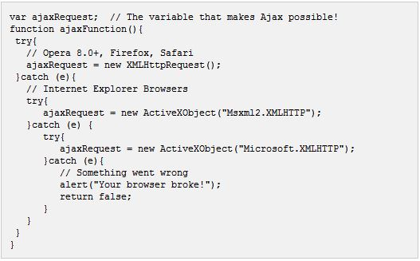
2. The XMLHttpRequest object is created

Slide 5
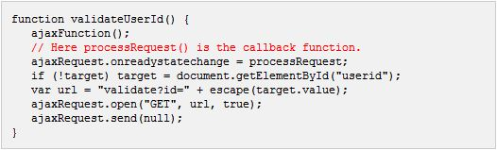
3. The XMLHttpRequest object is Configured
In this step we will write a function which will be triggered by the client event and a callback function processRequest() will be registered

Slide 6
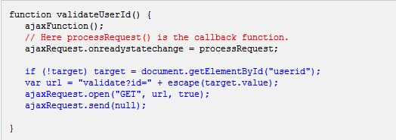
4. Making Asynchornous Request to the Webserver
Source code is available in the above piece of code. Code written in blue color is responsible to make a request to the web server. This is all being done using XMLHttpRequest object ajaxRequest
Assume if you enter Zara in userid box then in the above request URL is set to validate?id=Zara

Slide 7
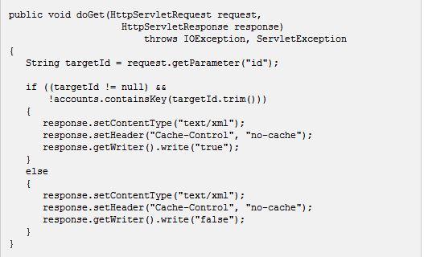
5. Webserver returns the result containing XML document
You can implement your server side script in any language. But logic should be as follows
Get a request from the client
Parse the input from the client
Do required processing.
Send the output to the client.
If we assume that you are going to write a servlet then here is the piece of code

Slide 8
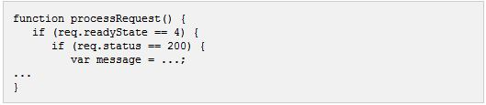
6. Callback function processRequest() is called
The XMLHttpRequest object was configured to call the processRequest() function when there is a state change to the readyState of the XMLHttpRequest object.
Now this function will recieve the result from the server and will do required processing.
As in the following example it sets a variable message on true or false based on retruned value from the Webserver.

Slide 9

7. The HTML DOM is updated
This is the final step and in this step your HTML page will be updated. It happens in the following way
JavaScript technology gets a reference to any element in a page using DOM API
The recommended way to gain a reference to an element is to call.

Slide 10


